Slide 1
* Additional settings required, see Y and WATERFALL commands

Slide 2



PowerPoint Template Engine - PeTE
demo template
and user guide
JIMMY SKOWRONSKI

Slide 3
OVERVIEW

Slide 4


PeTE
PeTE automates creation of data driven presentations by filling a PowerPoint template with the data from an Excel spreadsheet.
PeTE stands for PowerPoint Template Engine

Slide 5
Data driven presentations
PeTE separates the presentation design from the data leaving the look and feel entirely to the designer
PeTE is not affecting the design in any way and is not changing colours or the slide layout
PeTE allows rapid update of the presentation saving time

Slide 6

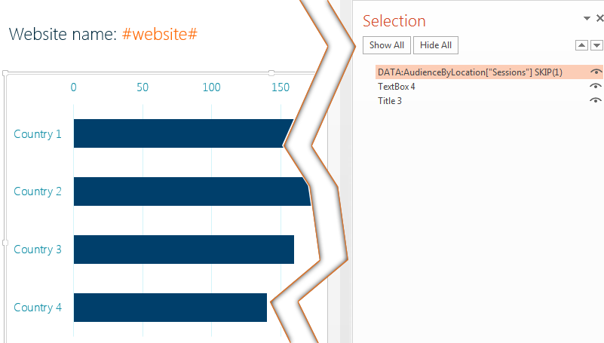
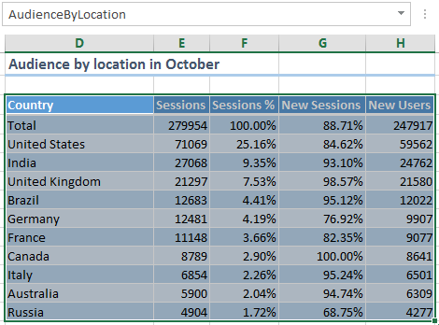
How PeTE works
Named ranges from the Excel are matched with PowerPoint elements using element names or special tags in the text.
single cell
the whole table

Slide 7

Limitations
Excel data can contain formulas, those are evaluated when PeTE reads the data
The data in Excel can be organised across multiple sheets
PeTE dos not recognises tables defined in Excel using “Format as Table” option
PowerPoint element names are limited to 255 characters
ThinkCell is not supported

Slide 8
USER GUIDE

Slide 9
Using this guide
This guide is also the template that demonstrates all features
Simply let PeTE process it, along with the demo Excel file, to learn how it works
Investigate element names to see applications
Compare before and after to see results

Slide 10
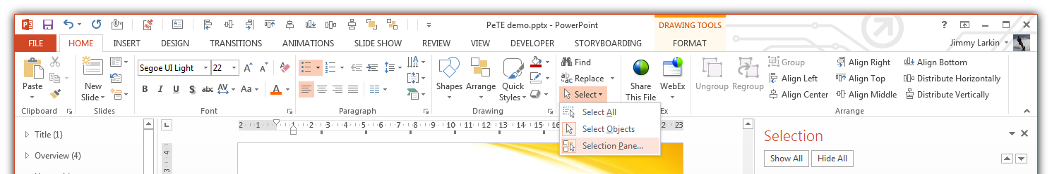
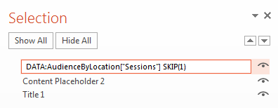
Naming elements in the PowerPoint
PeTE uses element names in the PowerPoint
To edit names open the Selection Pane
Double click on an element to edit its name
or select it and press F2

Slide 11
USER GUIDE
Working with data

Slide 12
Connecting elements to data
Using the element name
Use prefix DATA: followed by the range name from Excel
Inline using tags
Embed the range name from Excel in # characters
Website name: #website#

Slide 13
Single cell ranges
Single cells are useful for simple data such as
Client names
Dates
Define the named range with the single cell
Use the range name to get the data

Slide 14
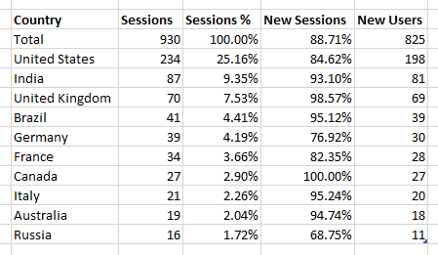
Multiple rows and columns ranges
For more complex data
The first row and the first column are interpreted as headers
Only if the range has at least two rows and two columns
Column headers
Data
Row headers

Slide 15
Indexing tables
Use indexes to retrieve only a fragment of the bigger table
Indexes are listed in []
First index columns then rows name[columns][rows]
Use column and row headers name[“column”] or numbers name[2]
Numbering starts from 0
Index multiple rows or columns using comma separated headers name[“column 1”, “column 2”]
Index multiple rows or columns using coma separated numbers name[1, 2] or range name[1-5]

Slide 16
Indexing single column
AudienceByLocation[“Sessions”]
AudienceByLocation[0]

Slide 17
Indexing multiple columns
AudienceByLocation[“Sessions”, “Sessions %”, “New sessions”]
AudienceByLocation[0, 1, 2]
AudienceByLocation[0-2]

Slide 18
Indexing single column and row
AudienceByLocation[“Sessions”][“United Kingdom”]
AudienceByLocation[0][3]

Slide 19
Indexing multiple columns and rows
AudienceByLocation[“Sessions”, “Sessions %”][“United Kingdom”, “Germany”, “France”]
AudienceByLocation[0, 1][3, 5, 6]

Slide 20
Indexing whole columns and rows
AudienceByLocation[“Sessions”][]
AudienceByLocation[0, 1][]
This text
will be
replaced by
the data
from
column
“Sessions”
AudienceByLocation[][“Brazil”]
AudienceByLocation[][4]
This text | will be replaced by data from | row “Brazil”

Slide 21
USER GUIDE
Inline text replacement

Slide 22
Inline text replacement
To replace the text inline simply enter the range name wrapped in the # character
Multiple replacements are allowed
Colour, style, font and other properties are preserved
Example:
Usage statistics for #website# generated on #ReportDate#

Slide 23
Inline text replacement with indexes
Inline replacement requires a single cell data
Otherwise only the most top left cell is used and rest of the table is ignored
All the examples below creates the same output
The website had #AudienceByLocation# visits in October
The website had #AudienceByLocation[“Sessions”][“Total”]# visits in October
The website had #AudienceByLocation[0][0]# visits in October

Slide 24
Values formatting with inline replacement
Certain values such as numeric, date and time can be additionally formatted
To format value add the format string after the name
The below example formats number separating 1000s by comma and the date to “long date format”
The website had #AudienceByLocation[0][0]:(“#,#”)# visits between #ReportPeriod[0][0]:(“D”)# and #ReportPeriod[0][1]:(“D”)#

Slide 25
Restrictions on values formatting
PeTE uses data type set in Excel to determine which formatting is possible
PeTE treat values as text if they are set as “General” format in Excel
Those can’t be formatted
Detailed information on formatting can be found on Formatting Types in the .NET Framework

Slide 26
Typical formatting
C – currency, formats 123.456 as $123.46
F – fixed-point, F2 formats 123.456 as 123.46
#,# - grouping by 1000s, formats 1234567 as 1,234,567
#.00 – two decimal places, formats 123.456 as 123.46, the same as F2
#,##.00 – the two above combined, formats 1234567.891 as 1,234,567.89
% - multiplies by 100 and formats as percentage, 0.53 as 53%
D – long date, formats date as 24 December 2014
d – short date, formats date as 2014/12/24
yyyy – four digit year
MM – two digit month
MMMM – month name
dd – two digit day number
ddd – abbreviated day of the week
dddd – full day of the week
yyyy-MM-dd – combined above, formats date as 2014-12-24

Slide 27
Culture specific formats
Currency and date format output depends on the country and the culture
Typically PeTE uses current regional settings set in Windows
Specific culture can be enforced
List of available cultures: National Language Support (NLS) API Reference
The below examples formats the number as a currency, the first in UK the second in USA
Hosting price in the UK is #HostingCost:(“C”, “en-GB”)# and #HostingCost:(“C”, “en-US”)# in the United States

Slide 28
USER GUIDE
Working with Powerpoint

Slide 29
Element content replacement
PeTE can replace content of any element on a slide
Except charts and tables as they are treated differently
Single cell from the data is used
The whole content of the element is replaced
Use ## to indicate where the data should be inserted whilst preserving everything else
This will be replaced
## visits in a month

Slide 30
Basics of tables
Tables is filled with the data replacing existing content
Only the data is used
Row and column headers are omitted
The table design is preserved
This text | Text in this column will be kept
will be | orange
replaced by
the data

Slide 31
When the table is smaller than the data
Additional rows and columns are added as needed
Styles of the last row and column are used
The table width is kept (columns are resized)
The table height increases with every added row
This text | Text in this column will be kept | Added columns will be
will be | orange | like this one
replaced by
the data
Added rows | will have the same style | as this one

Slide 32
When the table is bigger than the data
When the table is bigger than the data the table be shrunk by removing to be empty rows and columns
This text | Text in this column will be kept |  |  | This column will be
will be | orange |  |  | removed
replaced by
the data
 | Those two rows
 | will be removed

Slide 33
Basics of charts
Chart uses all data in similar way to tables
Rows are used as categories
Columns as series
Row and column headers are used
Row headers as category names
Column headers as series titles
The design is preserved

Slide 34
When the chart is smaller than the data
New series and categories are added as needed
Style of the last series are used to add new

Slide 35
When the chart is bigger than the data
Remaining series and categories are removed

Slide 36
Supported chart types
Bar chart
Column chart
Scatter plot*
Waterfall*
* Additional settings required, see Y and WATERFALL commands

Slide 37
USER GUIDE
Commands

Slide 38
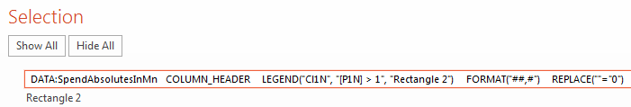
Commands
Allows advanced processing
Added to a element name
Arguments defined in ()
Multiple commands can be combined
Processed in order they are defined

Slide 39
ROW_HEADER, COLUMN_HEADER
Works only with tables
ROW_HEADER uses the first column for headers
COLUMN_HEADER uses the first row for column headers

Slide 40
TRANSPOSE
Transposes the data
Transposing the data twice returns it to the same orientation
Normal
Transposed

Slide 41
SKIP, TAKE
SKIP(n) skips the number (n) of rows from the top
TAKE(n) takes only specified number (n) of rows
HINT
Use TRANSPOSE before SKIP or TAKE to skip or take some columns and then transpose again to get the original orientation.

Slide 42
SORT
SORT(“column”, ASC) sorts data by the column
ASC sorts in ascending order, DESC in descending
Sort order is A-Z for text or 0-9 for numbers
HINT
Use TRANSPOSE before SORT to sort by a row and then transpose again to get the original orientation.

Slide 43
FORMAT
FORMAT([“column”], “format”, “culture”) applies format to the specified column
The column parameter is optional, without it the format is applied to the whole data

Slide 44
Restrictions on values formatting
PeTE uses data type set in Excel to determine which formatting is possible
PeTE treat values as text if they are set as “General” format in Excel
Detailed information on formatting can be found on Formatting Types in the .NET Framework
Values after formatting are set as text
Formulas will not work after format
Sort will work as A-Z sort, not 0-9

Slide 45
Typical formatting
C – currency, formats 123.456 as $123.46
F – fixed-point, F2 formats 123.456 as 123.46
#,# - grouping by 1000s, formats 1234567 as 1,234,567
#.00 – two decimal places, formats 123.456 as 123.46, the same as F2
#,##.00 – the two above combined, formats 1234567.891 as 1,234,567.89
% - multiplies by 100 and formats as percentage, 0.53 as 53%
D – long date, formats date as 24 December 2014
d – short date, formats date as 2014/12/24
yyyy – four digit year
MM – two digit month
MMMM – month name
dd – two digit day number
ddd – abbreviated day of the week
dddd – full day of the week
yyyy-MM-dd – combined above, formats date as 2014-12-24

Slide 46
Culture specific formats
Currency and date format output depends on the country and the culture
PeTE uses current regional settings set in Windows
Specific culture can be enforced
List of available cultures: National Language Support (NLS) API Reference

Slide 47
FORMULA
FORMULA(“expression”) evaluates the expression
The expression is evaluated for each row independently
Results are inserted in the new column
The result column is named Calc1, Calc2 etc.
Sessions | New users | Returning users
HINT
Results columns can be used as normal columns.
Use TRANSPOSE to calculate rows and then transpose back again.

Slide 48
Expressions in the FORMULA command
Reference columns using []
Typical mathematical operations are supported
+,-,*, /
Grouping fragments using ()
Constant values (numbers)
Examples:
FORMULA(“([Sessions] – [New Users]) * 12”)
FORMULA(“([Sessions] – [New Users]) * 12 / 1000”)

Slide 49
REPLACE
REPLACE(“value”=replacement) replaces specified value by inserting replacement
All columns and rows will be searched and replaced if the value match
Replace changes value to text so formulas will not work after replacement
Country | Promotion
HINT
Use special fonts to get symbols such as ticks (see the above example)

Slide 50
VISIBLE
VISIBLE(“expression”) shows or hides the element depend on the result of the expression
The expression must return true or false
If expression returns false then the element will be hidden
Only the green arrow and the green text will be visible in the example below
+##
-##

Slide 51
Expressions in the VISIBLE command
Reference columns using []
Typical mathematical operations are supported
+,-,*, /
Logical operators as in C# are supported
==,>,>=, <, <=, !=
Grouping fragments using ()
Constant values (numbers)
Use special [value] if the data is a single cell
Examples:
VISIBLE(“([Sessions] – [New Users]) > 15”)
VISIBLE(“(([Sessions] – [New Users]) * 12 / 1000) > 0”)

Slide 52
NO_CONTENT
Protects the element from it’s content being replaced
Useful in conjunction with VISIBLE (see arrows in the example)
This will be stay
This will be replaced

Slide 53
FIXED on tables
FIXED used on a table stops PeTE from expanding or shrinking the table if the data is bigger or smaller
If the data is smaller than the table then remaining rows and columns will be left intact
If the data is bigger then the overflow data will be ignored
The table is bigger than the data. Only yellow area will be filled.
The table is smaller than the data. Column “New users” and row “France” will be ignored.
 |  | This text will be
 |  | left intact

Slide 54
FIXED on charts
FIXED used on a chart stops PeTE from expanding or shrinking the chart if the data is bigger or smaller
If the data has less columns than the chart series then the remaining series are set to empty, otherwise columns are ignored
If the data has less rows than the chart then the remaining categories are hidden, otherwise rows are ignored
The chart has one series and two categories whilst the data has two columns and three rows. Overflow rows and columns will be ignored.
The chart has two series and three categories. One series will be set empty and one category will be hidden.

Slide 55
LEGEND
LEGEND(“column”, “expression”, “element”) evaluates the expression and if it returns true then
Fill colour, outline and text properties are taken from the element on the slide
and applied to the table column or the chart series specified as the column
> 500 visits
< 100 visits

Slide 56
WATERFALL
WATERFALL converts any stacked bar or column chart to a waterfall
Use only single from the data column, the first row will be used as total
The chart should have only one series

Slide 57
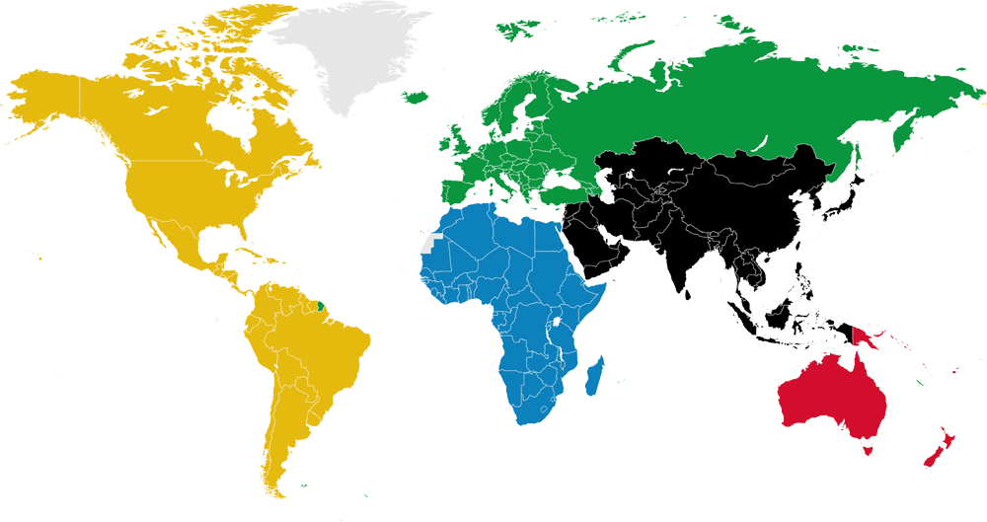
Y and scatter plots
The Y(“column”) command sets values for Y axis for scatter plots to specified column
The X axis values are indexed as in any other chart
More than one Y axes are available with multiple Y commands

Slide 58
ERROR_BAR
ERROR_BAR(“plus column”, “minus column”) sets error bars for a chart
The plus and minus columns will set plus and minus values correspondingly
One ERROR_BAR per series on the chart

Slide 59
USER GUIDE
troubleshooting

Slide 60
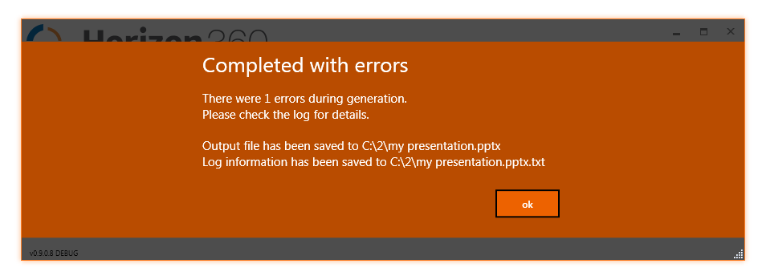
Error notification
Notification is displayed if the processing encounters any problems

Slide 61
Troubleshooting
Log file is created every time
Contains:
Template and data files
Step by step processing information
Detailed error and warning messages
Timing for each processing step and each slide

Slide 62
Future plans

Slide 63
Future plans
Add support for more chart types
Line, pie, surface, radar, bubble
Improve commands versatility
Build custom PowerPoint plugin to improve user experience and bypass 255 characters limit
Convert to the hosted SaaS product

Slide 64
Thank you
Please contact me for any questions or Comments
jimmy Skowronski

